Slide 1
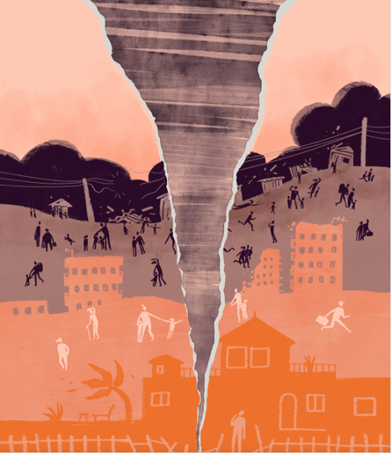
Disruption to Test Scores after Tropical Cyclones in the United States
Art by Amy Wolfe
Gabriella Y Meltzer, Joan A Casey, Joel Schwartz, Michelle L Bell, G Brooke Anderson, Marianthi-Anna Kioumourtzoglou, Jared Fox, Robbie M Parks
September XX, 2023
Email: gm3085@cumc.columbia.edu
Twitter: @gabriellameltz

Slide 2
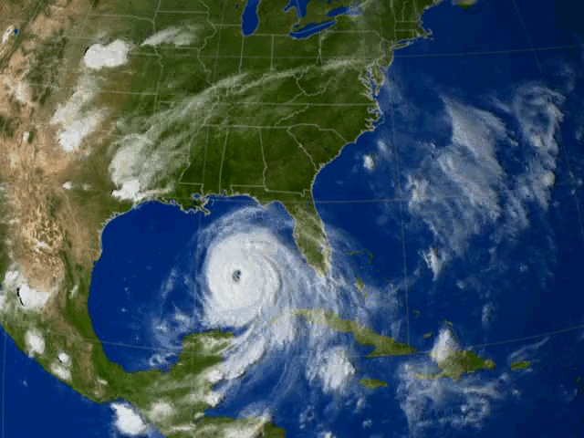
What is a tropical cyclone?
2
Notes:
Time (1 min)
CLICK then leave!
Tropical cyclones, such as hurricanes and tropical storms (such as Henri right now), as you can see an example of here, are intense circular storms that originate over warm tropical oceans and are characterized by low atmospheric pressure, and high wind speeds
They draw energy from the sea surface and maintain strength as long as they remain over warm water
When they make landfall it can be extremely disruptive and very destructive
Several hurricane-force tropical cyclones live long in the memory of many people in the United States
Why should we care about them in relation to health?
CLICK

Slide 3
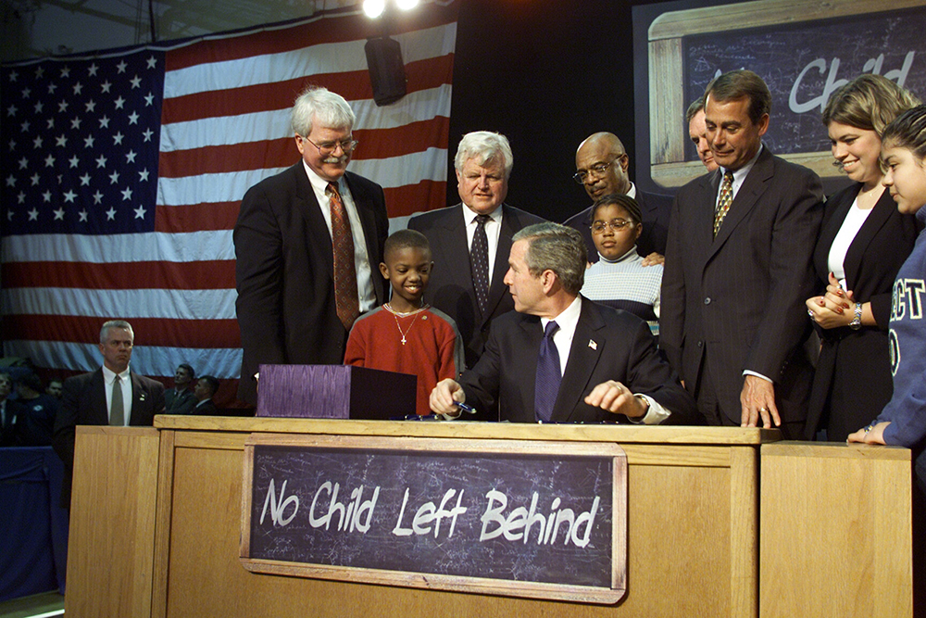
US educational system
2001 No Child Left Behind Act requires all states to test academic progress in math and reading/language arts
Tests administered to students in grades 3-8 typically in spring
Paul Morse/White House
3
Notes:
Robbie: Standardized testing
SEDAC info? https://exhibits.stanford.edu/data/catalog/db586ns4974

Slide 4
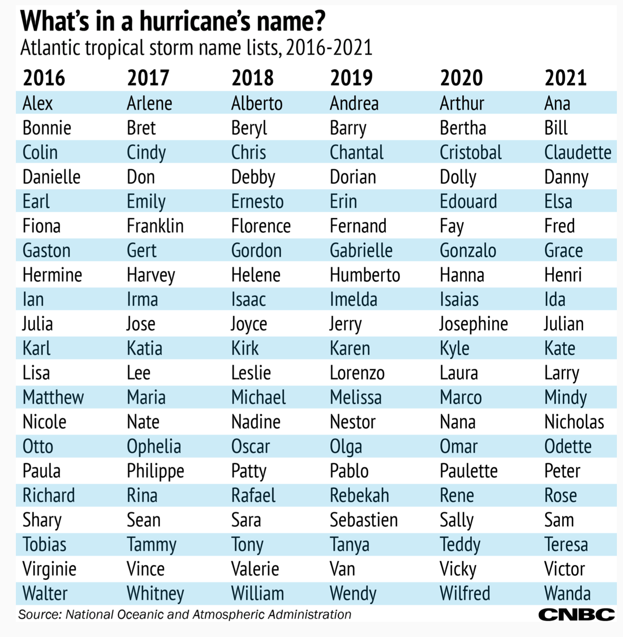
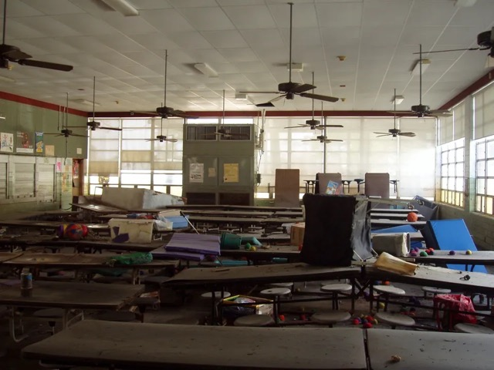
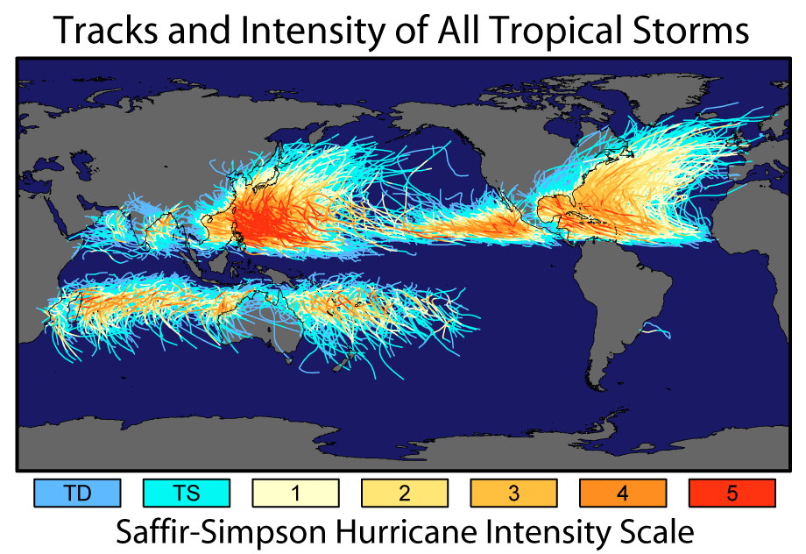
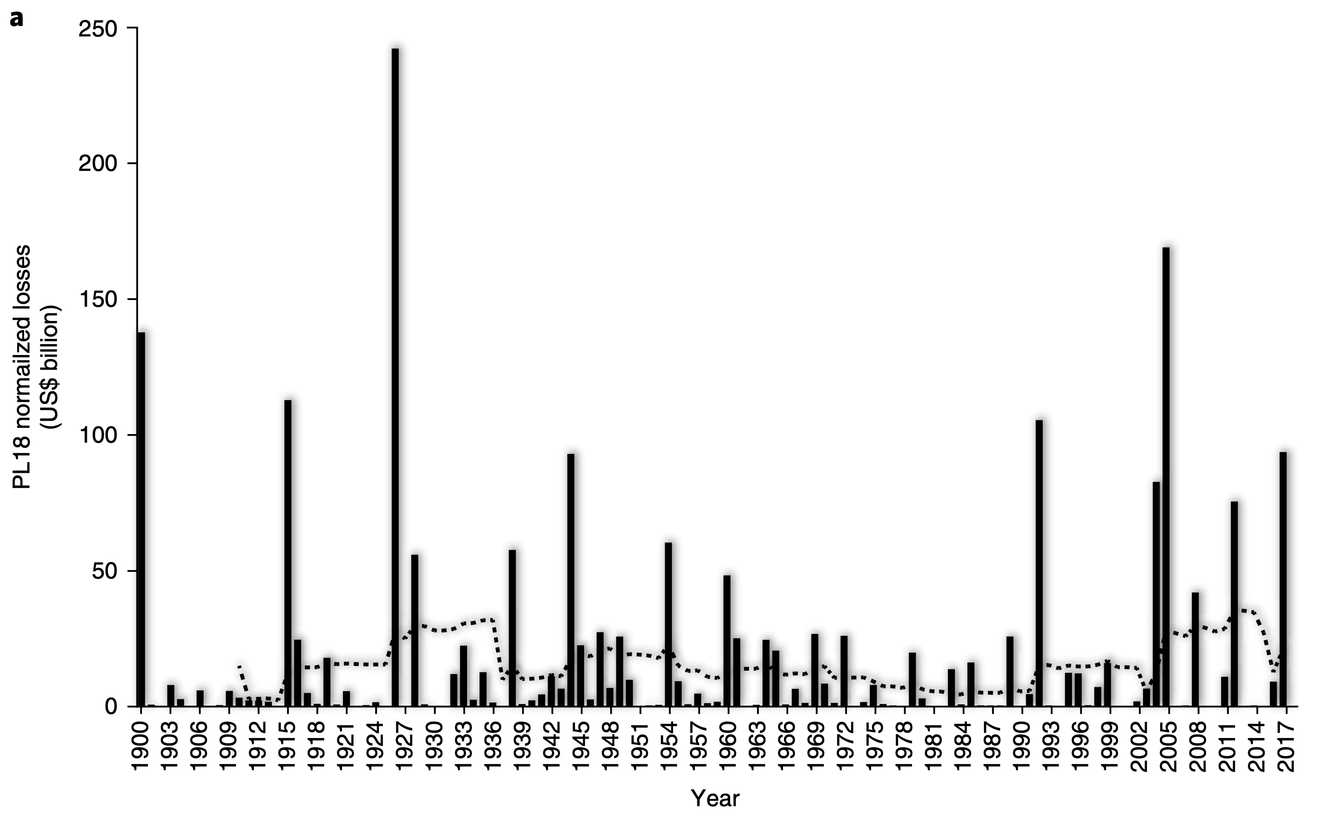
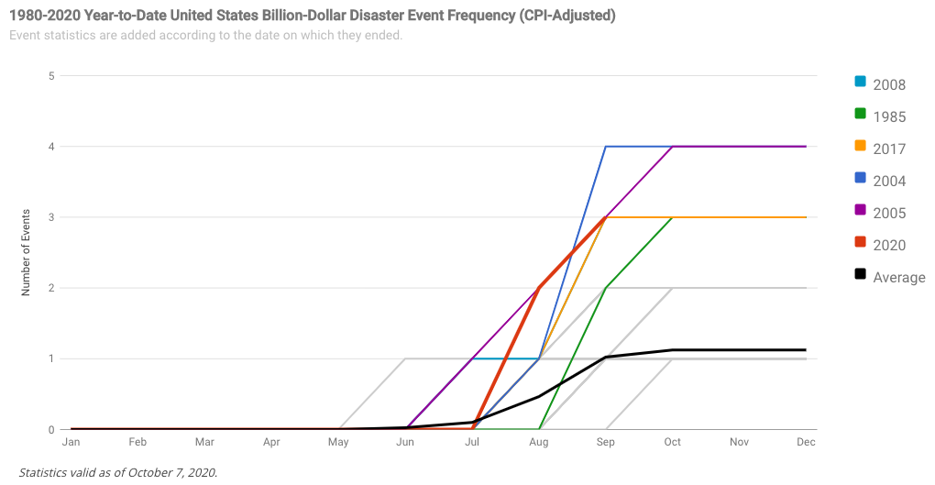
Why should we care about tropical cyclones?
Very active in US
2020 season most active on record
2021: 3rd time on record names exhausted
Will remain a threat in US
Longer landfall and peak closer to land
Extremely costly
Over $2 trillion in damage
Evidence of serious educational consequences
Hurricane Katrina displaced 100k-200k students
Destroyed 78% of New Orleans public school buildings
Cyclones are a deadly threat in many vulnerable parts of the world
Knowledge of US impacts helps worldwide efforts
Resilience is a matter of environmental justice
Impact low-income and historically disadvantaged communities
Normalized US hurricane damage from 1900 to 2017.
Landward migration of global tropical cyclone activity.
NOAA
Wang and Toumi, Science, 2021
NASA
Weinkle et al., Nature Sustainability, 2018
NOAA
4
Huffington Post

Slide 5
Disruption to Test Scores after Tropical Cyclones in the United States
Art by Amy Wolfe
Hurricanes and other tropical cyclones have devastating effects on society
A comprehensive assessment of their impacts on educational attainment over multiple years of study is lacking, despite plausible links
5
Meltzer et al., In preparation (please do not share or distribute)

Slide 6
Aims
Examine the association between tropical cyclones and educational attainment among elementary- and middle school-age students in all affected areas in the United States
Evaluate how the effects vary by strength of tropical cyclone and by sociodemographic composition of the student bodies and communities affected
6
Meltzer et al., In preparation (please do not share or distribute)

Slide 7
Study population, outcome and exposure assessment
Study population
Third to eighth grade students from 2009-2018 in 2,420 counties in contiguous US
Outcome assessment
County-level average standardized test scores in math and reading/language arts (RLA)
Stanford Educational Data Archive
Exposure assessment
Tropical cyclone exposure
Counties with sustained maximal wind speeds
Tropical cyclones: ⩾ 34 knots
Hurricanes: ⩾ 64 knots
7
Meltzer et al., In preparation (please do not share or distribute)
Notes:
The SEDA test scores are scaled such that a score of 4 is equal to the average national NAEP score across four cohorts of students in fourth grade in the spring of 2009, 2011, 2013, and 2015.
According to SEDA documentation, “1 unit in this metric is equal to the average per-grade increase in scores between fourth and eighth grade for those same cohorts, assuming usual grade promotion.” This allows scores to be comparable across the entire US, over time, and across grades

Slide 8
Statistical model
Association between average Math and RLA and tropical cyclone exposure:
Bayesian formulation of difference-in-differences model
To quantify association:
Associations modeled by tropical cyclones and hurricanes
Associations modeled nationally and by state
Effect modification by county and grade cohort level characteristics
Adjusted for time-varying grade-cohort and county-level covariates:
Grade-cohort: race/ethnicity, economic disadvantage, free lunch
County: ELL students, special education students, college rate, poverty, urbanicity, single mother households
8
Meltzer et al., In preparation (please do not share or distribute)

Slide 9
Figure 1. County-Level Tropical Cyclone and Hurricane Exposure, 2009-2018

Slide 10
Table 1. Univariate Statistics
 |  | Grade | 2009 percentiles |  |  |  |  | 2018 percentiles
Grade-specific standardized test scores |  |  | 5th | 25th | 50th | 75th | 95th | 5th | 25th | 50th | 75th | 95th
 | Mean Standardized Math Score | 3 | 1.33 | 2.34 | 2.90 | 3.39 | 4.06 | 1.57 | 2.40 | 2.95 | 3.42 | 4.20
 |  | 4 | 2.28 | 3.26 | 3.82 | 4.29 | 5.06 | 2.28 | 3.28 | 3.88 | 4.41 | 5.21
 |  | 5 | 3.07 | 4.16 | 4.80 | 5.30 | 6.04 | 3.03 | 4.14 | 4.79 | 5.36 | 6.24
 |  | 6 | 4.07 | 5.17 | 5.82 | 6.42 | 7.19 | 3.87 | 5.15 | 5.81 | 6.42 | 7.38
 |  | 7 | 4.85 | 6.12 | 6.82 | 7.39 | 8.24 | 4.78 | 6.00 | 6.76 | 7.37 | 8.35
 |  | 8 | 5.78 | 7.11 | 7.87 | 8.49 | 9.43 | 5.56 | 6.95 | 7.74 | 8.48 | 9.48
 | Mean Standardized RLA Score | 3 | 1.35 | 2.36 | 2.96 | 3.47 | 4.29 | 1.28 | 2.41 | 3.04 | 3.58 | 4.37
 |  | 4 | 2.22 | 3.30 | 3.87 | 4.35 | 5.14 | 2.26 | 3.38 | 3.95 | 4.50 | 5.21
 |  | 5 | 3.17 | 4.24 | 4.82 | 5.34 | 6.08 | 3.09 | 4.23 | 4.85 | 5.42 | 6.13
 |  | 6 | 4.19 | 5.23 | 5.81 | 6.34 | 7.04 | 4.17 | 5.22 | 5.84 | 6.39 | 7.18
 |  | 7 | 5.07 | 6.17 | 6.73 | 7.20 | 7.94 | 5.16 | 6.20 | 6.81 | 7.30 | 8.06
 |  | 8 | 6.03 | 7.13 | 7.68 | 8.18 | 8.89 | 6.16 | 7.15 | 7.75 | 8.28 | 9.05
Grade cohort level variables | Percent American Indian/Alaska Native |  | 0.0 | 0.0 | 0.2 | 0.5 | 8.3 | 0.0 | 0.0 | 0.2 | 0.4 | 3.8
 | Percent Asian |  | 0.0 | 0.0 | 0.6 | 1.4 | 4.5 | 0.0 | 0.2 | 0.6 | 1.3 | 5.0
 | Percent Hispanic |  | 0.0 | 1.1 | 3.0 | 8.6 | 42.3 | 0.7 | 2.6 | 6.5 | 15.8 | 52.8
 | Percent Black |  | 0.0 | 1.2 | 4.6 | 20.8 | 64.9 | 0.0 | 1.0 | 3.8 | 19.3 | 62.8
 | Percent Free Lunch |  | 17.4 | 29.9 | 40.5 | 51.5 | 70.6 | 23.5 | 38.1 | 49.0 | 61.4 | 92.7
 | Percent Economically Disadvantaged |  | 24.3 | 39.6 | 51.0 | 61.9 | 81.6 | 30.5 | 46.3 | 57.2 | 68.8 | 99.6
County level variables | Percent English Language Learners |  | 0.0 | 0.1 | 1.0 | 3.6 | 11.7 | 0.0 | 0.5 | 1.8 | 5.1 | 13.8
 | Percent Urban Schools |  | 0.0 | 0.0 | 0.0 | 0.0 | 52.4 | 0.0 | 0.0 | 0.0 | 0.0 | 54.0
 | Percent with College Degree |  | 9.1 | 12.4 | 15.8 | 21.2 | 34.4 | 10.6 | 14.3 | 18.1 | 23.8 | 38.9
 | Percent Living in Poverty |  | 7.1 | 11.6 | 15.3 | 19.2 | 26.0 | 8.0 | 12.1 | 15.7 | 19.7 | 26.1
 | Percent Single-Mother Households |  | 9.9 | 13.3 | 15.9 | 19.5 | 27.3 | 10.3 | 13.6 | 16.5 | 20.2 | 28.3
 | Percent Special Education |  | 0.0 | 11.0 | 13.7 | 16.1 | 19.8 | 9.1 | 12.2 | 14.3 | 16.7 | 20.7

Slide 11
Figure 2. Tropical Cyclone Results, Math

Slide 12
Figure 3. Tropical Cyclone Results, RLA

Slide 13
Figure 4. Hurricane Results, Math

Slide 14
Figure 5. Hurricane Results, RLA

Slide 15
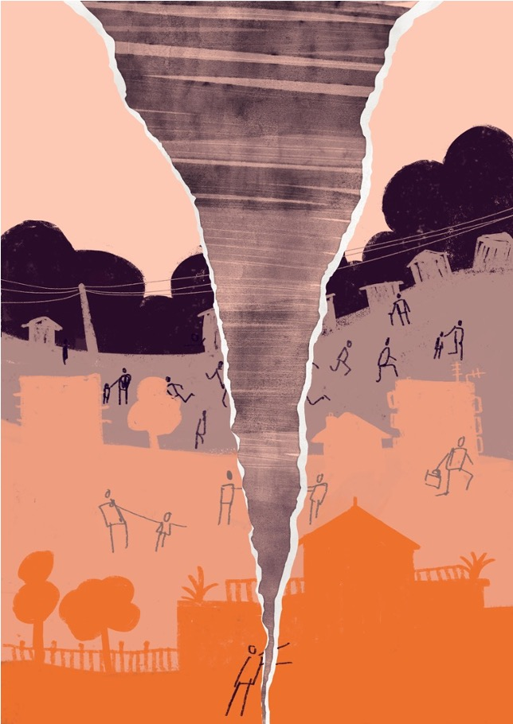
Summary
Negative, null, and positive associations between hurricanes and test scores in different states
Florida (+)
Texas, North Carolina (-)
May be dependent on state-level hurricane preparedness and recovery education policies, influxes of federal funding, or post-disaster student absence
Certain groups at greater risk of lapses in educational attainment
Native American, Black, Hispanic/Latinx
Low socioeconomic status
English language learners (RLA)
Other groups at greater advantage in educational attainment
Asian
Special education
College educated
15
Meltzer et al., In preparation (please do not share or distribute)
Notes:
Also good to note that we conducted several sensitivity analyses, including truncated enrolment at 95th and 5th percentiles, lagged, and only one hurricane/tropical cyclone

Slide 16
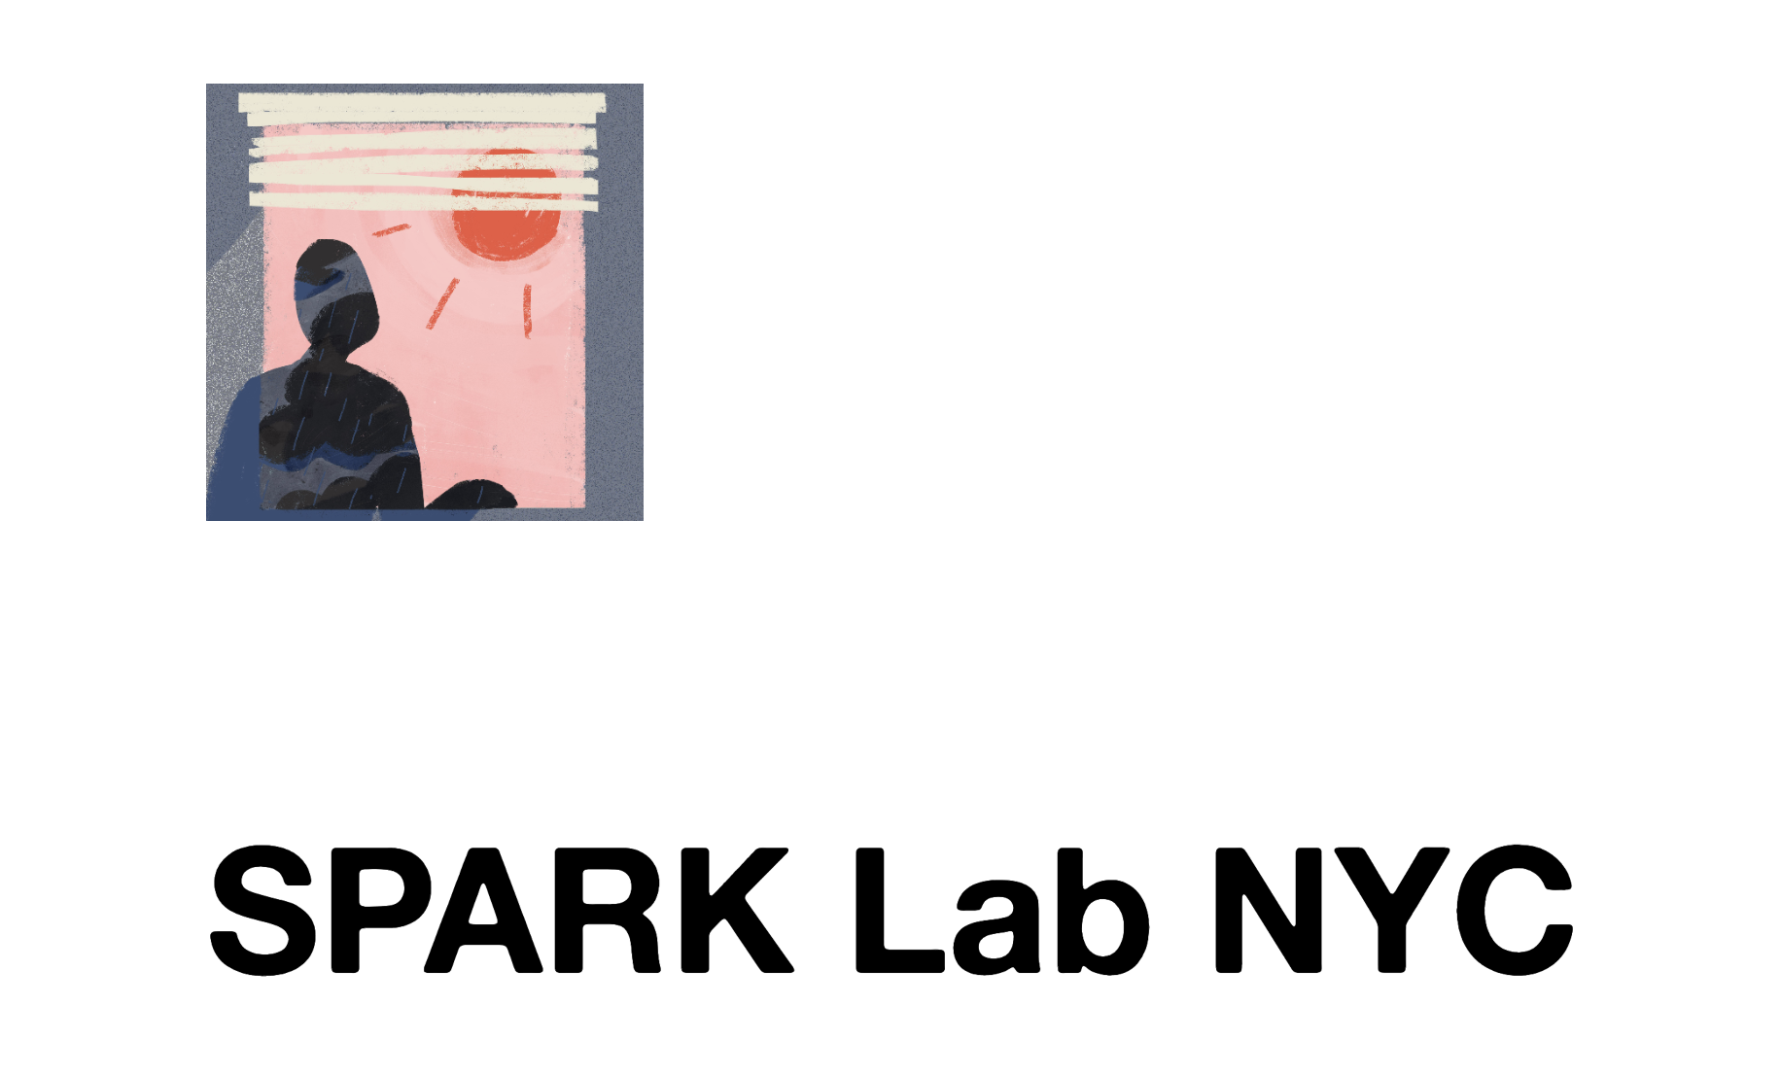
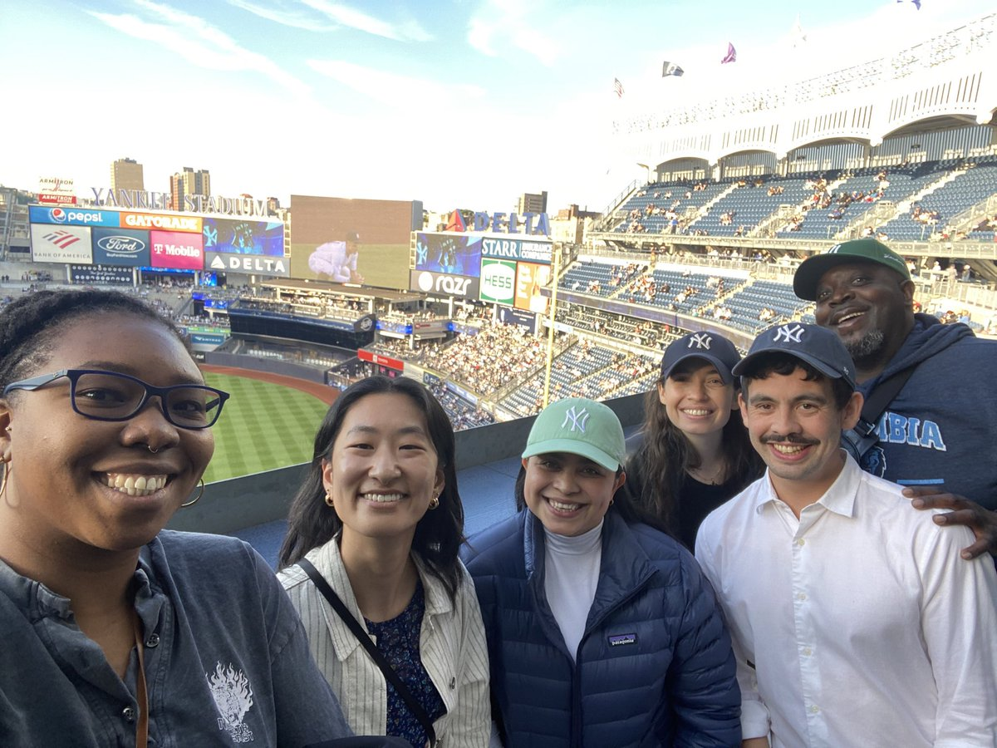

Co-authors, collaborators, and funding
University of Washington
Joan Casey
Columbia University
Gabriella Y Meltzer, Marianthi-Anna Kioumourtzoglou, Robbie M Parks
Harvard University
Joel Schwartz
Yale University
Michelle L Bell
Colorado State University
G Brooke Anderson
Supported by:
5T32ES007322-21
R00ES033742
16
Meltzer et al., In preparation (please do not share or distribute)

Slide 17
Disruption to Test Scores after Tropical Cyclones in the United States
Art by Amy Wolfe
Gabriella Y Meltzer, Joan A Casey, Joel Schwartz, Michelle L Bell, G Brooke Anderson, Marianthi-Anna Kioumourtzoglou, Robbie M Parks
September XX, 2023
Email: gm3085@cumc.columbia.edu
Twitter: @gabriellameltz

